Slide 1
Talent Development
At HCL

Slide 2
Frame Handling

Slide 3
IFrame
IFrame is a web page which is embedded in another web page.
The other way – it is an HTML document embedded inside another HTML document.
The IFrame is often used to insert content from another source, such as an advertisement, into a Web page.
The <iframe> tag specifies an inline frame.
To perform any operation on the IFrame, user needs to switch control from the parent window to the IFrame.

Slide 4
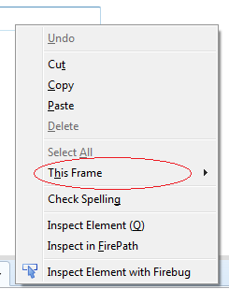
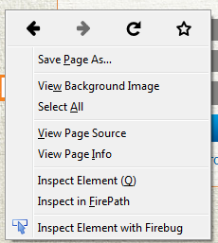
Iframe - Identification
Right click on the element. If there is option like “This Frame”, then it is an IFrame.
Right click on the page and select “View Page Source” and search for the text “frame”. If it is found, then the web page has a frame.
Normal page having no frame Page having iFrame in it.

Slide 5
Iframe – Switching to frame
Switch to frame by Name
driver.switchTo().frame(“Frame Name”);
Switch to frame by Web Element.
driver.switchTo().frame(<WebElement>);

Slide 6
Code

Slide 7
Code – Frame Handling
import java.util.List;
import org.openqa.selenium.By;
import org.openqa.selenium.WebDriver;
import org.openqa.selenium.WebElement;
import org.openqa.selenium.ie.InternetExplorerDriver;
import org.openqa.selenium.support.ui.ExpectedConditions;
import org.openqa.selenium.support.ui.WebDriverWait;
public class handlingFrame {
public static void main(String[] args) {
String url = "http://jqueryui.com/autocomplete/";
String textToSelect = "Java";
WebDriver frame_WD = new InternetExplorerDriver();
//frame_WD.manage().window().maximize();
frame_WD.get(url);
//frame_WD.manage().timeouts().implicitlyWait(20, TimeUnit.MINUTES);

Slide 8
Code – Frame Handling
WebElement frame_WE = frame_WD.findElement(By.className("demo-frame"));
frame_WD.switchTo().frame(frame_WE);
frame_WD.findElement(By.xpath(".//*[@id='tags']")).sendKeys("Java");
WebElement autoOption = frame_WD.findElement(By.id("ui-id-1"));
WebDriverWait wait = new WebDriverWait (frame_WD, 10);
wait.until(ExpectedConditions.visibilityOf(autoOption));
//List <WebElement> optionsToSelect = autoOption.findElements(By.tagName("li"));
//List <WebElement> optionsToSelect = autoOption.findElements(By.xpath("//div[starts-with(@id,'ui-id')]"));
List <WebElement> optionsToSelect = autoOption.findElements(By.xpath("//div[contains(@id,'ui-id')]"));
for(WebElement option : optionsToSelect){
if(option.getText().equals(textToSelect)) {
System.out.println("Trying to Select = "+ textToSelect);
option.click();
break;
}
}
}
}

Slide 9
Code
Download the code from https://github.com/sangramkswain/HCLPuneTraining
File Name – Sessions.zip

